Slide 1
Figure 11-1: A Tree
A
B
C
D
E
F
26年 11月 8日
Copyright © 1997 Oxford University Press
All Rights Reserved

Slide 2
Definition 11-1
A binary tree is either:
1. an empty tree; or
2. consists of a node, called a root, and two children, left and right, each of which are themselves binary trees.
26年 11月 8日
Copyright © 1997 Oxford University Press
All Rights Reserved

Slide 3
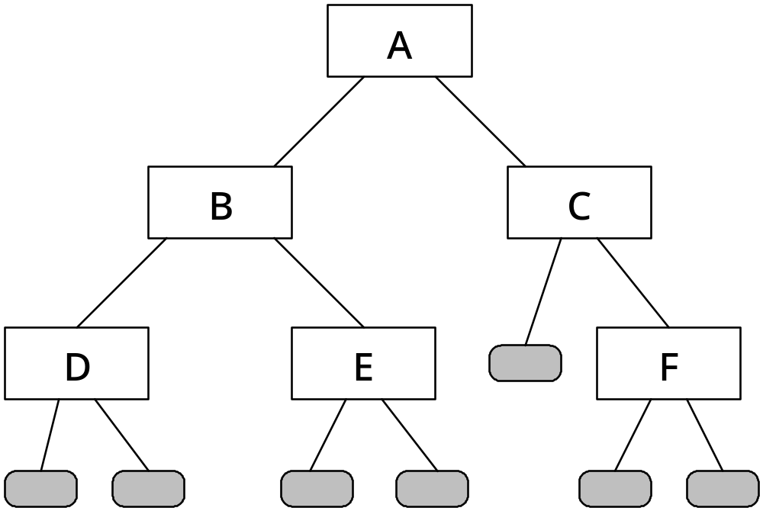
Figure 11-2: A Binary Tree
26年 11月 8日
Copyright © 1997 Oxford University Press
All Rights Reserved

Slide 4
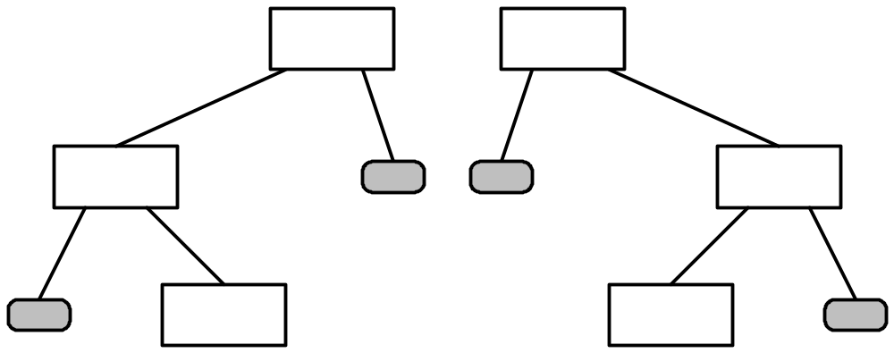
Figure 11-3: Two distinct Binary Trees
26年 11月 8日
Copyright © 1997 Oxford University Press
All Rights Reserved

Slide 5
Figure 11-4: Expression tree for
3 + 7 × 2 - 1
-
+
1
3
X
7
2
26年 11月 8日
Copyright © 1997 Oxford University Press
All Rights Reserved

Slide 6
ADT 11-1
Characteristics
• A Binary Tree ADT T stores data of some type (btElementType), using a binary tree as defined in Definition 11-1 on Page 269.
Operations
bool T.isEmpty()
Precondition: None.
Postcondition: None.
Returns: true if and only if T is an empty tree
26年 11月 8日
Copyright © 1997 Oxford University Press
All Rights Reserved

Slide 7
ADT 11-1
btElementType T.getData()
Precondition: !T.isEmpty()
Postcondition: None.
Returns: The data associated with the root of the tree.
void T.insert(btElementType d)
Precondition: !T.isEmpty()
Postcondition: T.getData()==d
26年 11月 8日
Copyright © 1997 Oxford University Press
All Rights Reserved

Slide 8
ADT 11-1
BinaryTree T.left()
Precondition: !T.isEmpty()
Postcondition: None
Returns: The left child of T
BinaryTree T.right()
Precondition: !T.isEmpty()
Postcondition: None
Returns: The right child of T
26年 11月 8日
Copyright © 1997 Oxford University Press
All Rights Reserved

Slide 9
ADT 11-1
void T.makeLeft()
Precondition: !T.isEmpty();T.left().isEmpty()
Postcondition: T.left() == T1
void T.makeRight()
Precondition: !T.isEmpty();T.right().isEmpty()
Postcondition: T.right() == T1
26年 11月 8日
Copyright © 1997 Oxford University Press
All Rights Reserved

Slide 10
Code Example 11-1
// cx11-1.h
// Code Example 11-1: Interface File: Binary Tree
#ifndef __MB_CX11_1__
#define __MB_CX11_1__
#include "dslib.h"
template < class btElementType >
class BinaryTree {
public:
BinaryTree();
bool isEmpty() const;
// Precondition: None.
// Postcondition: None.
// Returns: true if and only if T is an empty tree
26年 11月 8日
Copyright © 1997 Oxford University Press
All Rights Reserved

Slide 11
Code Example 11-1
btElementType getData() const; // getData is an accessor
// Precondition: !this->isEmpty()
// Postcondition: None
// Returns: The data associated with the root of the tree
void insert(const btElementType & d);
// Precondition: none
// Postconditions: this->getData() == d; !this->isEmpty()
BinaryTree * left();
// Precondition: !this->isEmpty()
// Postcondition: None
// Returns: (a pointer to) the left child of T
BinaryTree * right();
// Precondition: !this->isEmpty()
// Postcondition: None
// Returns: (a pointer to) the right child of T
26年 11月 8日
Copyright © 1997 Oxford University Press
All Rights Reserved

Slide 12
Code Example 11-1
void makeLeft(BinaryTree * T1);
// Precondition: !this->isEmpty(); this->left()->isEmpty()
// Postcondition: this->left() == T1
void makeRight(BinaryTree * T1);
// Precondition: !this->isEmpty(); this->right()->isEmpty()
// Postcondition: this->right() == T1
private:
bool nullTree;
btElementType treeData;
BinaryTree * leftTree;
BinaryTree * rightTree;
};
#endif
26年 11月 8日
Copyright © 1997 Oxford University Press
All Rights Reserved

Slide 13
Code Example 11-2
// cx11-2.cpp
// Code Example 11-2: Implementation File: Binary Tree
#include "cx11-1.h"
template < class btElementType >
BinaryTree < btElementType > :: BinaryTree()
{
nullTree = true;
leftTree = 0;
rightTree = 0;
}
26年 11月 8日
Copyright © 1997 Oxford University Press
All Rights Reserved

Slide 14
Code Example 11-2
template < class btElementType >
bool
BinaryTree < btElementType > :: isEmpty() const
{
return nullTree;
}
template < class btElementType >
btElementType
BinaryTree < btElementType > :: getData() const
{
assert(!isEmpty());
return treeData;
}
26年 11月 8日
Copyright © 1997 Oxford University Press
All Rights Reserved

Slide 15
Code Example 11-2
template < class btElementType >
void
BinaryTree < btElementType >
:: insert(const btElementType & d)
{
treeData = d;
if (nullTree) {
nullTree = false;
leftTree = new BinaryTree;
rightTree = new BinaryTree;
}
}
26年 11月 8日
Copyright © 1997 Oxford University Press
All Rights Reserved

Slide 16
Code Example 11-2
template < class btElementType >
BinaryTree < btElementType > *
BinaryTree < btElementType > :: left()
{
assert(!isEmpty());
return leftTree;
}
template < class btElementType >
BinaryTree < btElementType > *
BinaryTree < btElementType > :: right()
{
assert(!isEmpty());
return rightTree;
}
26年 11月 8日
Copyright © 1997 Oxford University Press
All Rights Reserved

Slide 17
Code Example 11-2
template < class btElementType >
void
BinaryTree < btElementType >
:: makeLeft(BinaryTree * T1)
{
assert(!isEmpty());
assert(left()->isEmpty());
delete left();
leftTree = T1;
}
26年 11月 8日
Copyright © 1997 Oxford University Press
All Rights Reserved

Slide 18
Code Example 11-2
template < class btElementType >
void
BinaryTree < btElementType >
:: makeRight(BinaryTree * T1)
{
assert(!isEmpty());
assert(right()->isEmpty());
delete right();
rightTree = T1;
}
26年 11月 8日
Copyright © 1997 Oxford University Press
All Rights Reserved

Slide 19
Figure 11-8: The operation of Code Example 11-3
bt6
A
bt3
B
bt5
C
bt1
D
bt2
E
bt4
F
26年 11月 8日
Copyright © 1997 Oxford University Press
All Rights Reserved

Slide 20
Code Example 11-3
// cx11-3.cpp
// Code Example 11-3: Simple Client for Binary Tree
#include "cx11-1.h"
#include <iostream.h>
int main()
{
typedef BinaryTree < char > charTree;
typedef charTree * charTreePtr;
// Create tree from Figure 11-2
// Create left subtree (rooted at B)
26年 11月 8日
Copyright © 1997 Oxford University Press
All Rights Reserved

Slide 21
Code Example 11-3
// Create B's left subtree
charTreePtr bt1(new charTree);
bt1->insert('D');
// Create B's right subtree
charTreePtr bt2(new charTree);
bt2->insert('E');
// Create node containing B, and link
// up to subtrees
charTreePtr bt3(new charTree);
bt3->insert('B');
bt3->makeLeft(bt1);
bt3->makeRight(bt2);
// ** done creating left subtree
26年 11月 8日
Copyright © 1997 Oxford University Press
All Rights Reserved

Slide 22
Code Example 11-3
// Create right subtree
// Create C's right subtree
charTreePtr bt4(new charTree);
bt4->insert('F');
// Create node containing C, and link
// up its right subtree
charTreePtr bt5(new charTree);
bt5->insert('C');
bt5->makeRight(bt4);
// ** done creating right subtree
26年 11月 8日
Copyright © 1997 Oxford University Press
All Rights Reserved

Slide 23
Code Example 11-3
// Create the root of the tree, and link together
charTreePtr bt6(new charTree);
bt6->insert('A');
bt6->makeLeft(bt3);
bt6->makeRight(bt5);
// print out the root
cout << "Root contains: " << bt6->getData() << endl;
// print out root of left subtree
cout << "Left subtree root: " << bt6->left()->getData() << endl;
// print out root of right subtree
cout << "Right subtree root: " << bt6->right()->getData() << endl;
26年 11月 8日
Copyright © 1997 Oxford University Press
All Rights Reserved

Slide 24
Code Example 11-3
// print out leftmost child in tree
cout << "Leftmost child is: " <<
bt6->left()->left()->getData() << endl;
// print out rightmost child in tree
cout << "Rightmost child is: " <<
bt6->right()->right()->getData() << endl;
return 0;
}
26年 11月 8日
Copyright © 1997 Oxford University Press
All Rights Reserved

Slide 25
실습예제
Binary tree를 구현하자
BT 라는 프로젝트를 만들고
프로젝트->새항목추가-> BinaryTree.h 를 추가하고 내용은 9-17쪽의 내용을 넣는다.
Main 함수안에 19-23 내용을 넣는다
실행해본다.
새로운 binary tree를 만드는데, 가장 하단이 A,B,C,D이고 그 위의 단이 E,F 이고 가장 위가 G인 tree를 구성해보자
26年 11月 8日
Copyright © 1997 Oxford University Press
All Rights Reserved

Slide 26
Figure 11-17: A Binary Search Tree
17
10
26
6
14
20
34
11
31
37
26年 11月 8日
Copyright © 1997 Oxford University Press
All Rights Reserved

Slide 27
ADT 11-12
Characteristics
* A Binary Search Tree ADT T stores data of some type (btElementType), using a binary search tree as defined in Definition 11-2 on Page 292.
Prerequisites
The data type btElementType must implement the < and == operators.
26年 11月 8日
Copyright © 1997 Oxford University Press
All Rights Reserved

Slide 28
ADT 11-2
Operations
bool T.isEmpty()
Precondition: None.
Postcondition: None.
Returns: true if and only if T is an empty tree.
btElementType T.getData()
Precondition: !T.isEmpty()
Postcondition: None.
Returns: The data associated with the root of the tree
26年 11月 8日
Copyright © 1997 Oxford University Press
All Rights Reserved

Slide 29
ADT 11-2
void T.insert(btElementType d)
Precondition: !T.isEmpty(); T meets the BST invariant
Postcondition: T.retrieve(d).getData() == d; T meets the BST invariant.
BinaryTree T.retrieve(btElementType d)
Precondition: T meets the BST invariant.
Postcondition: T meets the BST invariant.
Returns: if T contains a node with data d, then T.retrieve(d).getData() == d; otherwise, T.retrieve(d).isEmpty().
26年 11月 8日
Copyright © 1997 Oxford University Press
All Rights Reserved

Slide 30
ADT 11-2
BinaryTree T.left()
Precondition: !T.isEmpty()
Postcondtion: None.
Returns: The left child of T
BinaryTree T.right()
Precondition: !T.isEmpty()
Postcondtion: None.
Returns: The right child of T
26年 11月 8日
Copyright © 1997 Oxford University Press
All Rights Reserved

Slide 31
Figure 11-20: A Binary Search Tree showing position where 12 would be inserted
17
10
26
6
14
20
28
11
31
37
26年 11月 8日
Copyright © 1997 Oxford University Press
All Rights Reserved

Slide 32
Figure 11-21: The Binary Search Tree after 12 inserted
17
10
26
6
14
20
28
11
31
37
12
26年 11月 8日
Copyright © 1997 Oxford University Press
All Rights Reserved

Slide 33
Figure 11-22: Inheritance diagram for BinaryTree and BST
BinaryTree
BST
26年 11月 8日
Copyright © 1997 Oxford University Press
All Rights Reserved

Slide 34
Code Example 11-12
template < class btElementType >
class BST : public BinaryTree < btElementType > {
public:
BST();
virtual void insert(const btElementType & d);
// Precondition: if d is a left child, then d must be < parent->getData();
// if d is a right child, then d must be > parent->getData();
// Postconditions: T->retrieve(k)->getData() == d
26年 11月 8日
Copyright © 1997 Oxford University Press
All Rights Reserved

Slide 35
Code Example 11-12
virtual BinaryTree < btElementType > * retrieve(const btElementType & d);
// Precondition: none
// Postcondition: none
// Returns: if T contains a node matching d, then
// T->retrieve(d)->getData() == d; otherwise, T->isEmpty()
};
#endif
26年 11月 8日
Copyright © 1997 Oxford University Press
All Rights Reserved

Slide 36
Code Example 11-13
template < class btElementType >
void
BST < btElementType >
:: insert(const btElementType & d)
{
if (nullTree) {
nullTree = false;
leftTree = new BST;
rightTree = new BST;
treeData = d;
}
else if (d == treeData)
treeData = d;
else if (d < treeData)
leftTree->insert(d);
else
rightTree->insert(d);
}
26年 11月 8日
Copyright © 1997 Oxford University Press
All Rights Reserved

Slide 37
Code Example 11-13
template < class btElementType >
BinaryTree < btElementType > *
BST < btElementType >
:: retrieve(const btElementType & d)
{
if (nullTree || d == treeData)
return this;
else if (d < treeData)
return leftTree->retrieve(d);
else
return rightTree->retrieve(d);
}
template < class btElementType >
BST < btElementType >
:: BST() : BinaryTree < btElementType >()
{
}
26年 11月 8日
Copyright © 1997 Oxford University Press
All Rights Reserved

Slide 38
Code Example 11-11
// cx11-11.cpp
// Code Example 11-11: Sample Client of BST
#include "cx11-9.h"
int main()
{
typedef BST < int > intBST;
typedef intBST * intBSTPtr;
intBSTPtr b(new intBST);
b->insert(17);
b->insert(10);
b->insert(26);
b->insert(6);
b->insert(14);
26年 11月 8日
Copyright © 1997 Oxford University Press
All Rights Reserved

Slide 39
Code Example 11-11
b->insert(20);
b->insert(28);
b->insert(11);
b->insert(31);
b->insert(37);
b->insert(12);
// is 11 in the tree?
intBSTPtr get11(b->retrieve(11));
if (get11->isEmpty())
cout << "11 not found.\n";
else
cout << "11 found.\n";
// is 13 in the tree?
26年 11月 8日
Copyright © 1997 Oxford University Press
All Rights Reserved

Slide 40
Code Example 11-11
intBSTPtr get13(b->retrieve(13));
if (get13->isEmpty())
cout << "13 not found.\n";
else
cout << "13 found.\n";
return 0;
}
26年 11月 8日
Copyright © 1997 Oxford University Press
All Rights Reserved

Slide 41
실습예제
Binary Search Tree 구현해보자
Project 이름을 BinarySeachTree로 해서 구성한다.
이전 프로젝트의 BinaryTree.h 파일을 현재 작업 디렉토리에 복사하고, 프로젝트->기존항목추가에서 파일을 추가한다
프로젝트->새항목추가에서 BST.h 를 추가하고 33-36내용을 복사하고, binaryTree.h를 include 한다
Main 함수에 37-39 내용을 복사하고 bst.h include 를 한다
컴파일한다
  이걸 어떻게 한다 ㅠㅠㅠ=> googling
26年 11月 8日
Copyright © 1997 Oxford University Press
All Rights Reserved

Slide 42
실습예제 계속
먼저 상속의 개념에서 생각해보자
  BinaryTree의 멤버 변수들은 상속해서 사용하고자 하면 protected 로 변경해야 함
Retrieve에서 에러가 나오는데 형이 안맞다고 나옴. => ((BST <btElementType> *) leftTree)->retrieve(d) 로 고치고 rightTree 도 고침
이와 같은 형 변환은 main 함수에서도 수행 해줘야 함 => intBSTPtr get11((BST<int>*)b->retrieve(11) 로 고침 이와 같이 get13도 고침
여전히 안되서 힘들죠? 이것 찾느라 나도 진짜 힘들었어요. 끝으로 BinaryTree.h에서 insert 함수앞에 virtual 붙임.
26年 11月 8日
Copyright © 1997 Oxford University Press
All Rights Reserved

Slide 43
Template 상속을 정리
Template 부모 클래스를 상속받을때는 부모 클래스에서는 다음을 체크
  멤버변수는 protected여서 자식이 access 가능한가
  멤버 함수중 자식이 같은 이름으로 다시 사용하면 재정의 로는 잘 안되므로 virtual로 부모 자식 함수를 사용한다
Template 자식 클래스가 부모로 부터 상속받은 변수를 사용할때는 그 변수가 자신이 사용함을 알려야 한다.
  Explicit type casting
  This-> // 될때도 안될때도.
Main 함수에서도 명확한 type casting
  intBSTPtr get11((BST<int>*)b->retrieve(11) 이렇게
26年 11月 8日
Copyright © 1997 Oxford University Press
All Rights Reserved

